Slide 1
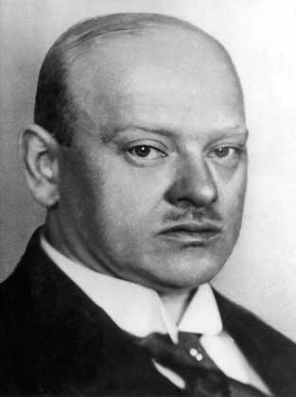
Gustav Stresemann (The Sequel)
Tuesday 21st June 2011
Shaun Fenech
Sean Gill
Liam McKenna

Slide 2

Problems Ahead!
Gustav Stresemann was the “saviour” of the Weimar Republic…BUT there were some things even he could not ‘fix’.
Due to these problems, historians believe that the prosperity of the Weimar Republic was largely an illusion.

Slide 3
Read p262 and 263
PROBLEMS
Economy
Culture
Politics
Foreign Policy

Slide 4
How far did the Weimar Republic recover after 1923?
Look at the state of the Weimar Republic in 1928. (Focus Task p263 ) Political Opposition Economic Problems Popular support Germany and the wider world Cultural Achievements
Rank each section out of 10
Include BOTH successes and failures – then come to an overall judgement.

Slide 5
How far did the Weimar Republic recover after 1923?
Cultural Achievements
Germany and the wider world
Popular support
Economic Problems
Political Opposition

Slide 6

How far did the Weimar Republic recover after 1923?
The Weimar Republic recovered to a small extent...
The Weimar Republic recovered to some extent...
The Weimar Republic recovered to a large extent...
“The Weimar Republic’s recovery and prosperity, was largely an illusion.”

Slide 7


Debate
With political pundits…
Daniel Ward
Matt Lee
Jack Williams
James Dickey
Luke Hogg
Tom Shields
Liam Fowles
How far did the Weimar Republic recover after 1923?

Slide 8

Was the Weimar Republic doomed from the start?

Slide 9


RULES
Hands up
Do not shout out
Say what you see!

Slide 10
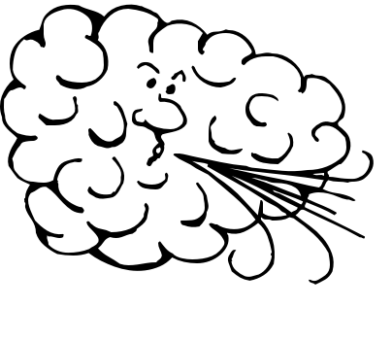
Say what you see!
AV

Slide 11

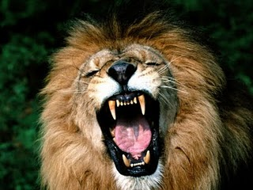
Say what you see!

Slide 12
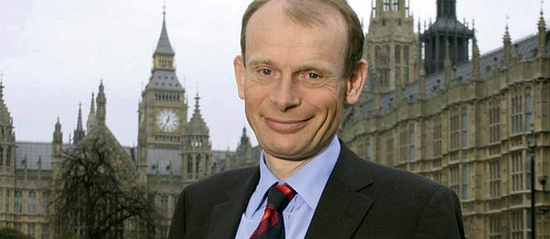
Say what you see!
Y

Slide 13

Say what you see!
PER

Slide 14

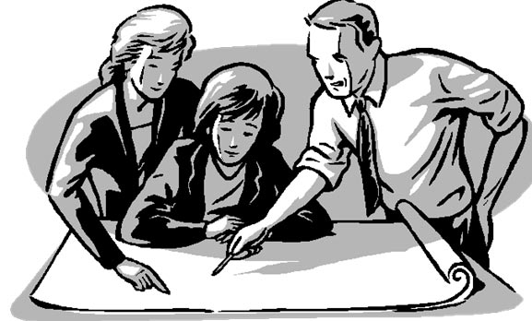
Say what you see!

Slide 15

Say what you see!

Slide 16


Say what you see!
?

Slide 17

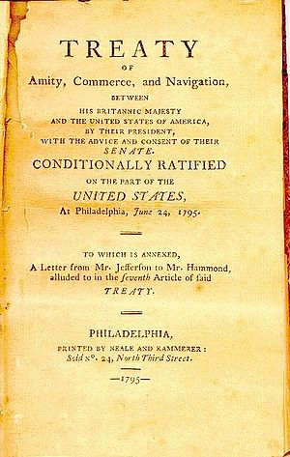

Say what you see!
R

Slide 18


Say what you see!

Slide 19

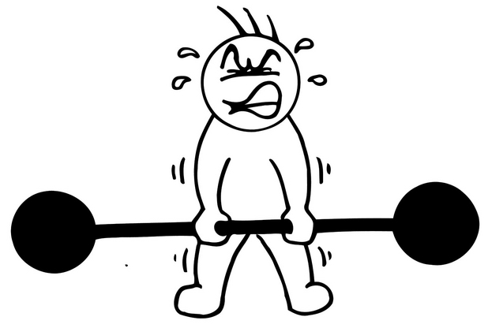
Say what you see!

Slide 20
Say what you see!
20
20
20
20
20
20
20
20
20
20
20
20
20
20

